Slide 1
Final Presentation
Patching - Anna, Kota, Jake, John, and Ryan

Slide 2
Objectives
Big patch problem: modify code to first calculate the overlap between two patches and then discard the patch that has the larger area
Understand and fix the small patch problem
Confirm our final patching algorithm works for slices with multiple contours
Discuss any other possible issues

Slide 3
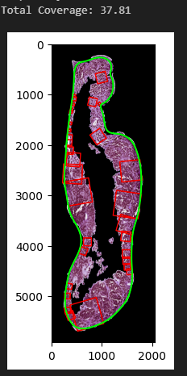
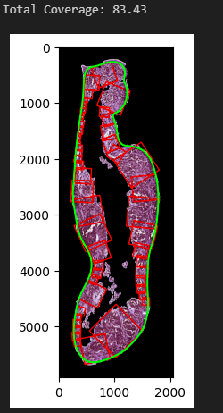
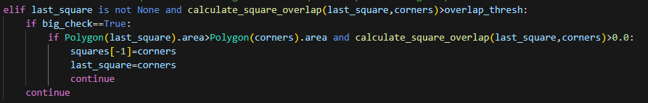
Discard the patch that has the larger area
Already checking overlap on last placed square
Add an additional area comparison for overlapping squares
Those that are smaller than previous patch take priority
Loss of many squares when keeping smaller and removing larger
Add additional check to ensure large overlap
This allows most squares to go unaltered
Removes excessively large squares
Does not add any additional loops or square creations
There is currently a reduction in coverage when removing larger squares
The algorithm still looks to average around 90% coverage
The majority of double patches seem to have disappeared

Slide 4
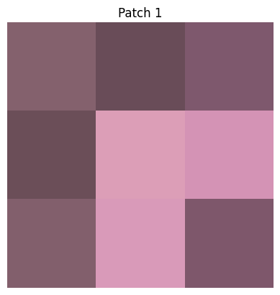
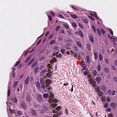

2. Small Patch Problem
Want to understand why our code creates small patches of 2x2 or 3x3 pixels
Modified the code to only show this one specific patch
Then looked at the mask and saw a small peninsula in the annotation
h&e_case_25_match_1

Slide 5
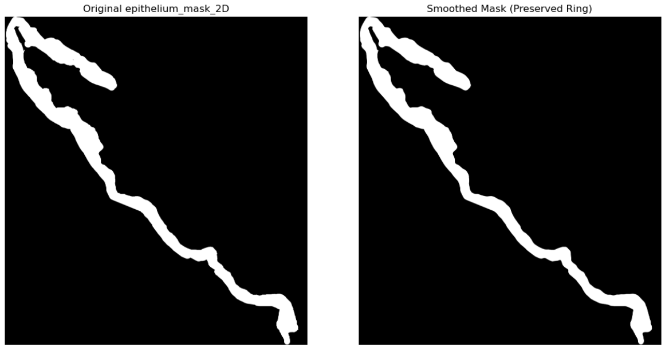
2. Small Patch Problem
Idea: Small patches are caused by imperfections in the masks (rough edges)
Potential solution: Smooth the mask to reduce jutting
Without mask smoothing:
With mask smoothing:
h&e_case_25_match_1

Slide 6
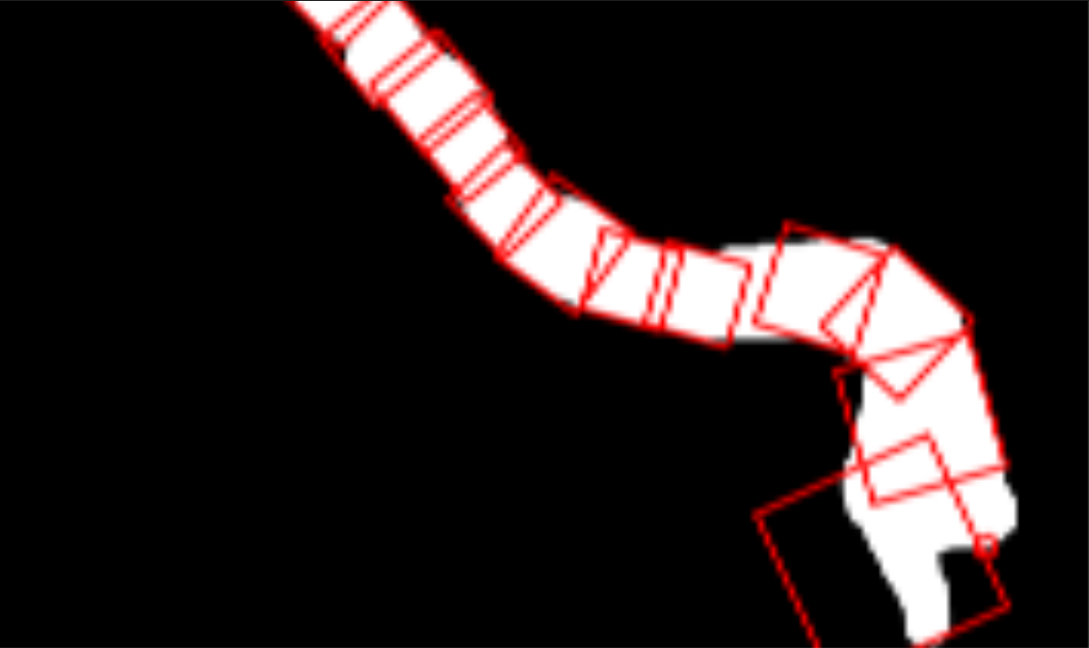
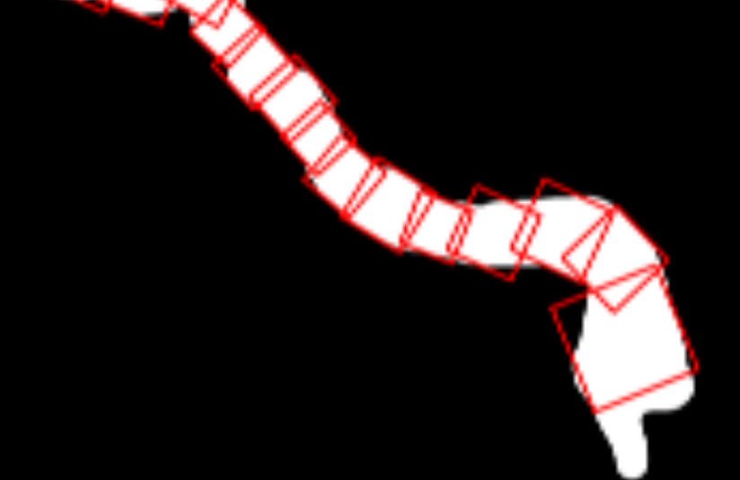
2. Small Patch Problem
Without mask smoothing:
With mask smoothing:
Small patch
h&e_case_25_match_1

Slide 7
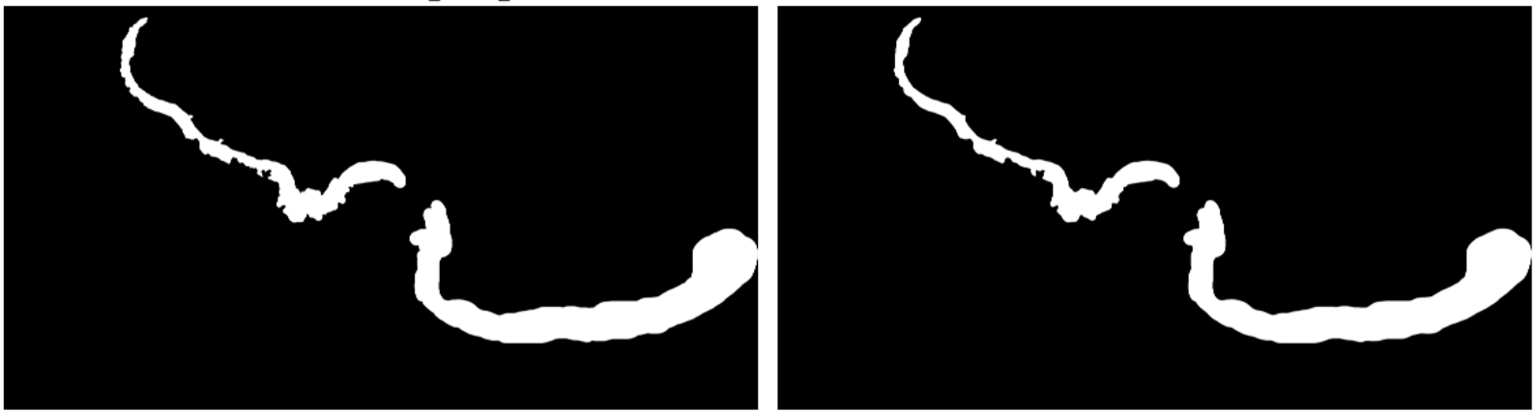
2. Small Patch Problem
Without mask smoothing:
With mask smoothing:
h&e_case_102_match_1

Slide 8
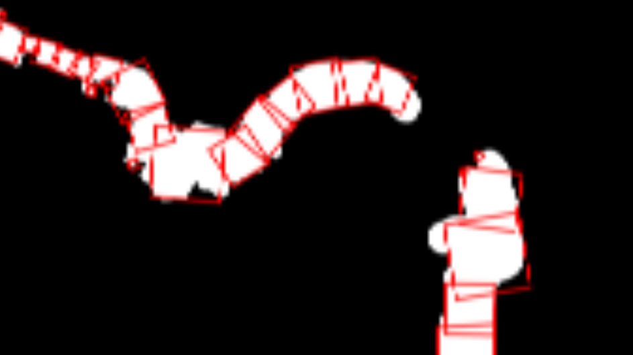
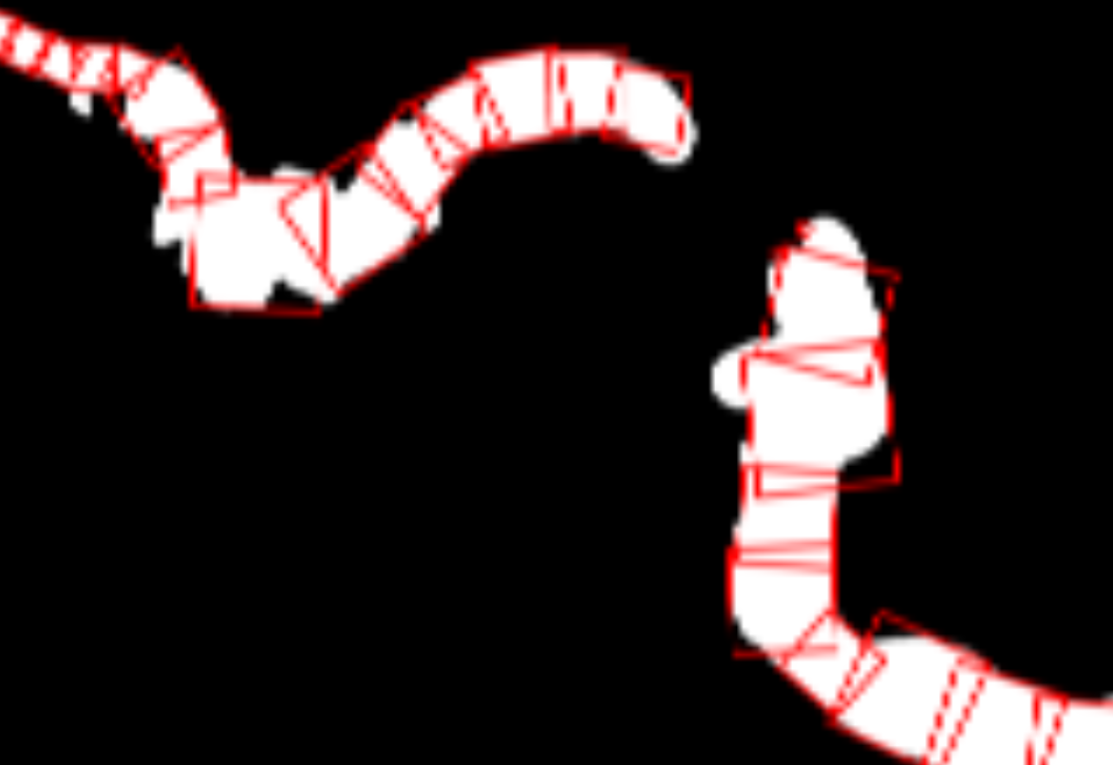
2. Small Patch Problem
Without mask smoothing:
With mask smoothing:
Small patches still form
Small patches
h&e_case_102_match_1

Slide 9
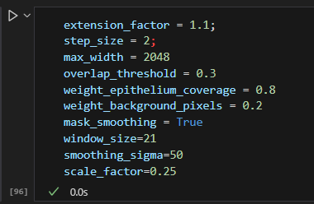
2. Small Patch Problem
Uses 3 additional parameters for smoothing
They only affect the mask, which is already subject to variation due to manual extraction
The same values are robust to masks I’ve tested
Default is False

Slide 10
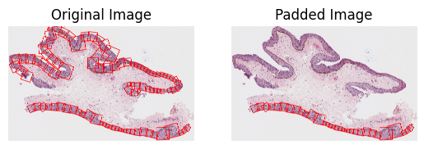
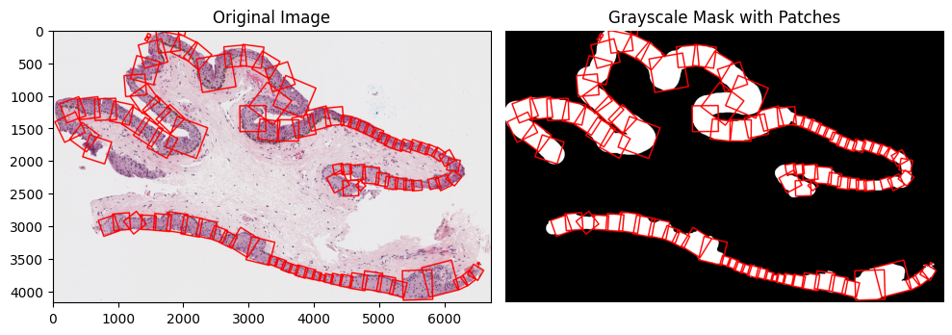
3. Slices with multiple contours
Code previously wasn’t creating/ exporting patches for slices with multiple contours
Before fixing:
After fixing:

Slide 11
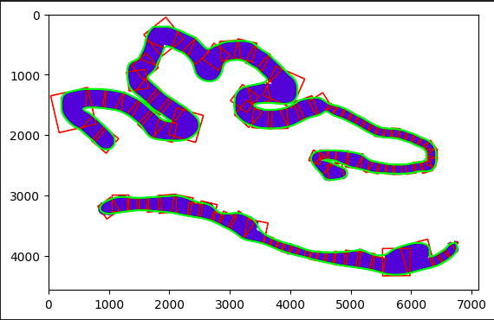
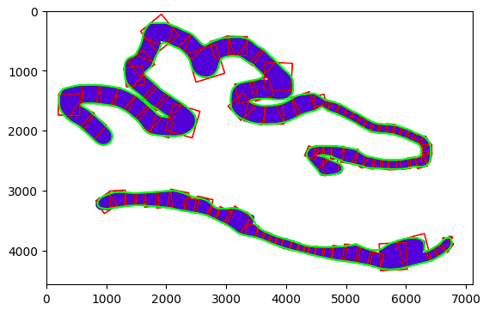
4. Other issues
Finding way to optimize sigma for Gaussian Smoothing
Can get an approximation of complexity from examining number of local maxima relative the length of a contour
Optimal sigma values seem to fall between 6-90, from testing
This value depends heavily on the windiness, noisiness, and size of the contour
This is not a solved parameter
Especially winding epitheliums can become over smoothed
GitHub

Slide 12
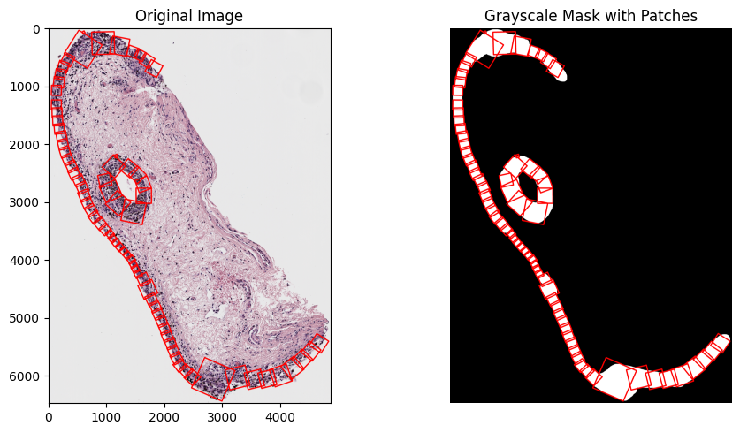
Final Algorithm!!!
Github Link
Since p5, we added the following features:
Ryan's Gaussian smoothing functionality for more optimal tangents (importantly eliminates smoothing_size as a parameter)
Anna's patch export functionality that allows all masks and tissue slices within the folder to be executed at once
Sharon's patching_export functionality that outputs the original image + the mask with patches included
John's epithelium-within-an-epithelium functionality in get_contour
Jake’s mask-smoothing functionality (set to False on default)

